Slide 1

VOLTORB - OCTOBER
Indicator Bulb Circuitry

Slide 2
If you are eager to get a solution for the given problem statement, but don’t know how to approach the question - don’t hesitate, we’ve got you covered, this Presentation is developed just for you!!!

Slide 3
Problem Statement
Hannah Baker, Clay Jensen, Justin Foley and Jessica Davis, founders of the German automobile start-up 'Versucci' are now being sued by a customer who met with an accident due to defective indicator bulbs of the car. The lawsuit would be taken back only if the company fixes all the defective bulbs circuitry.
Imagine yourself as the 'Head of manufacturing' team and you have been told to fix the defective bulbs circuitry. So it's upto you to build a proper indicator bulb circuitry and you have the following information.
1. The power supply available in the car is 24V DC only.
2. There are two 24V halogen bulbs that are used in indicator lights. These two bulbs have to flash one after the other.
3. The duration of ON and OFF state of each bulb should be around 3.3s and 3.2s respectively.
Instructions:
1. Do not vary the supply voltage.
2. Usage of microcontroller and ready-made sensor modules are NOT allowed.
3. Implementation of protective equipments and extra functionality to the circuit carries more marks.

Slide 4

Hints:
Use the following components
1. Voltage regulator IC
2. 555 timer
3. Relay

Slide 5
How to solve?
01
Identify the components required to solve the given problem statement.
02
Make the circuit connections.
03
If there exists any programmable components, write the code accordingly to get the components working.
04
Test and debug, finally add extra functionality and make it fancy.

Slide 6
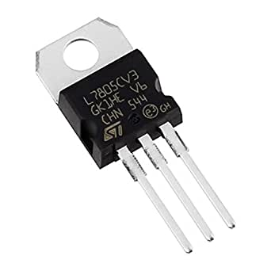
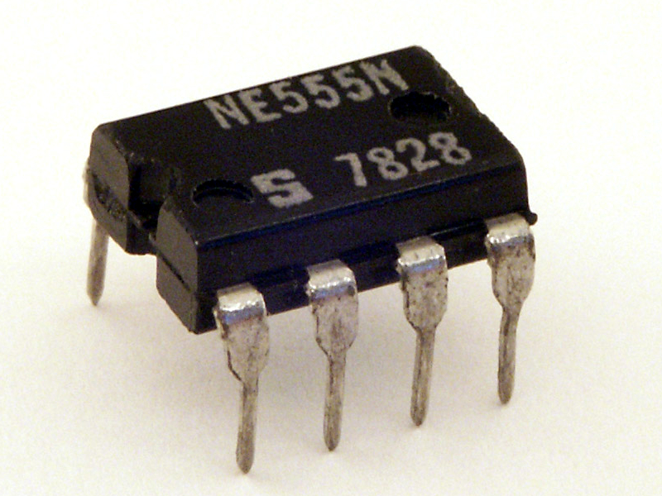
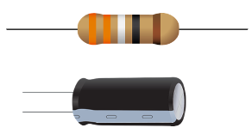
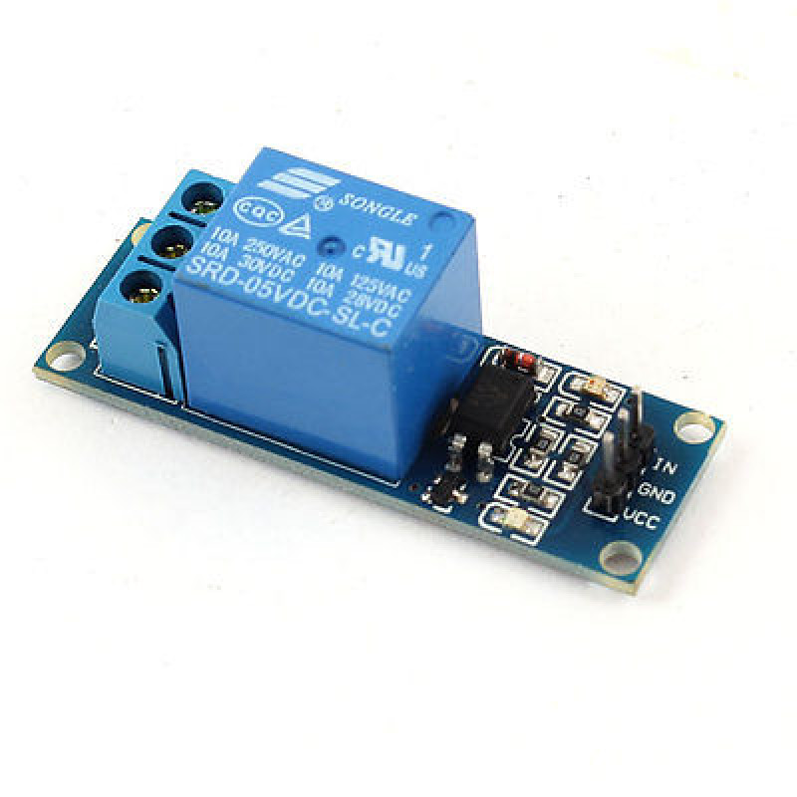
Gang members
yj
Use 555 timer in Astable mode to produce an output which oscillates at a particular frequency and generate pulses.
.
Use 5V relay as a switch to turn ON and OFF the bulb.
Use 7805 voltage regulator IC to regulate the supply voltage level.
Choose resistors and capacitors of suitable value to set the ON time and OFF time of the pulse.

Slide 7
How to make it work?
01
As specified in the question the power supply available in the car is 24V DC only, but 555 timer and relay requires a lesser operating voltage. So make use of a 7805 which is a positive voltage regulator IC to regulate the voltage from 24V to 5V and use this to power the timer and relay.
The Relay has to be turned ON and OFF by a timer, which in turn makes the two bulbs to turn ON and OFF. Here use 555 timer in astable mode to produce a pulse with predefined ON-time and OFF-time. Connect the circuit in such a way that Bulb 1 will be turned ON only during the ON-time and and Bulb 2 will be turned ON only during the OFF-time
01
02

Slide 8
The ON and OFF time of the pulse decides how long each bulb stays in ON state. As specified in the question ON and OFF time should be around 3.3s and 3.2s. Set this time by selecting the appropriate value of resistors and capacitors.
Formulae to calculate ON-time and OFF-time.
TON = 0.693(R2 + R1)C1
TOFF = 0.693(R2)C1
03
04
Now it’s done, simply turn ON the power supply and you should be able to notice each bulbs flashing one at a time.

Slide 9

Just like everyone had a reason to kill Bryce Walker, you have a reason to submit the solution ASAP!!!!
The company’s fate is in your hand

Slide 10
Check out these links for reference:
https://circuitdigest.com/electronic-circuits/555-timer-astable-multivibrator-circuit-diagram
https://www.electronicsforu.com/resources/learn-electronics/7805-ic-voltage-regulator
https://www.instructables.com/Controlling-AC-light-using-Arduino-with-relay-modu/

Slide 11
Thank you!
- IEEE UVCE PES

